Slide 1
Frothy Head Brewing Data Investigation

Slide 2
Tables and Data
The provided data sets along with the cleaned and merged data can be found in the accompanying files along with the tables for the following:
The number of breweries per state
Missing values per variable
Statistical summary of alcohol content
Most alcoholic Beer
Most bitter beer

Slide 3
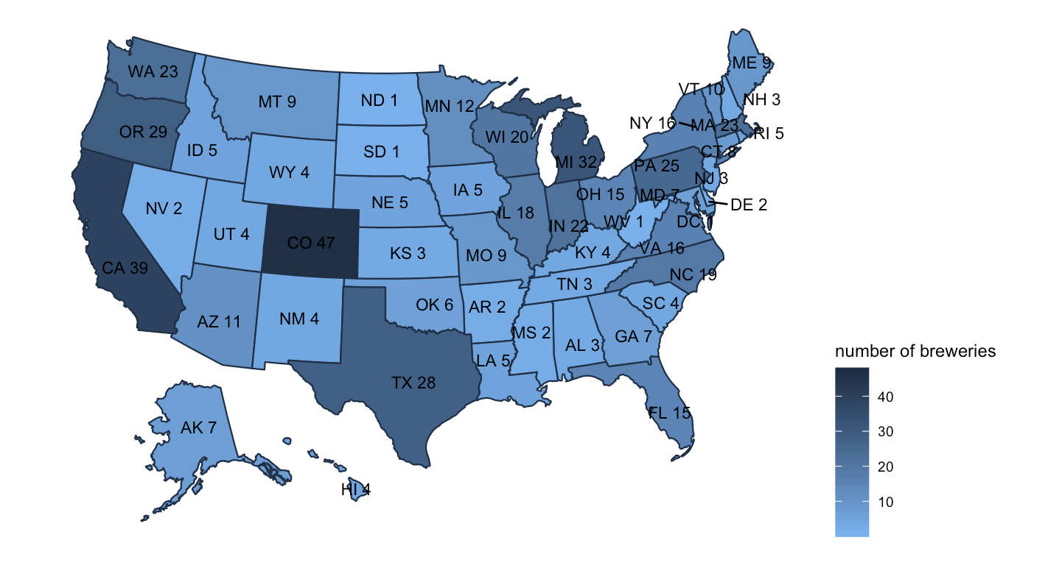
States Brewery Map

Slide 4
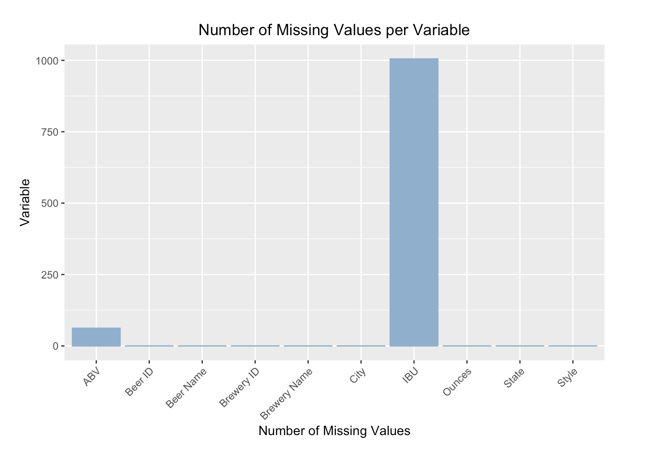
Missing Values

Slide 5
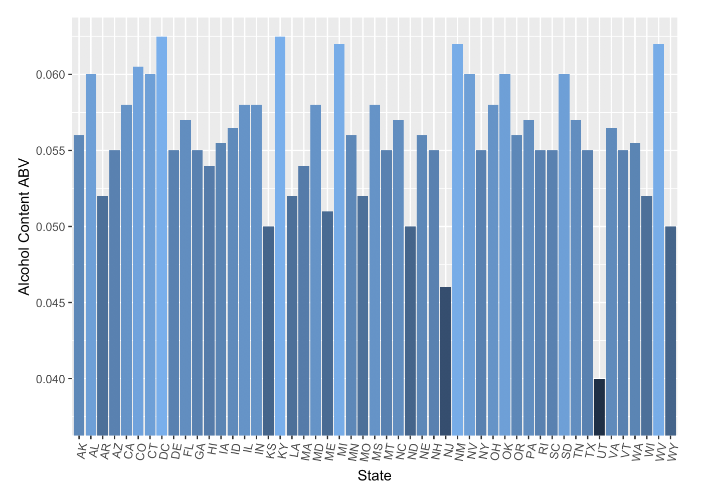
Median Alcohol Content by State

Slide 6
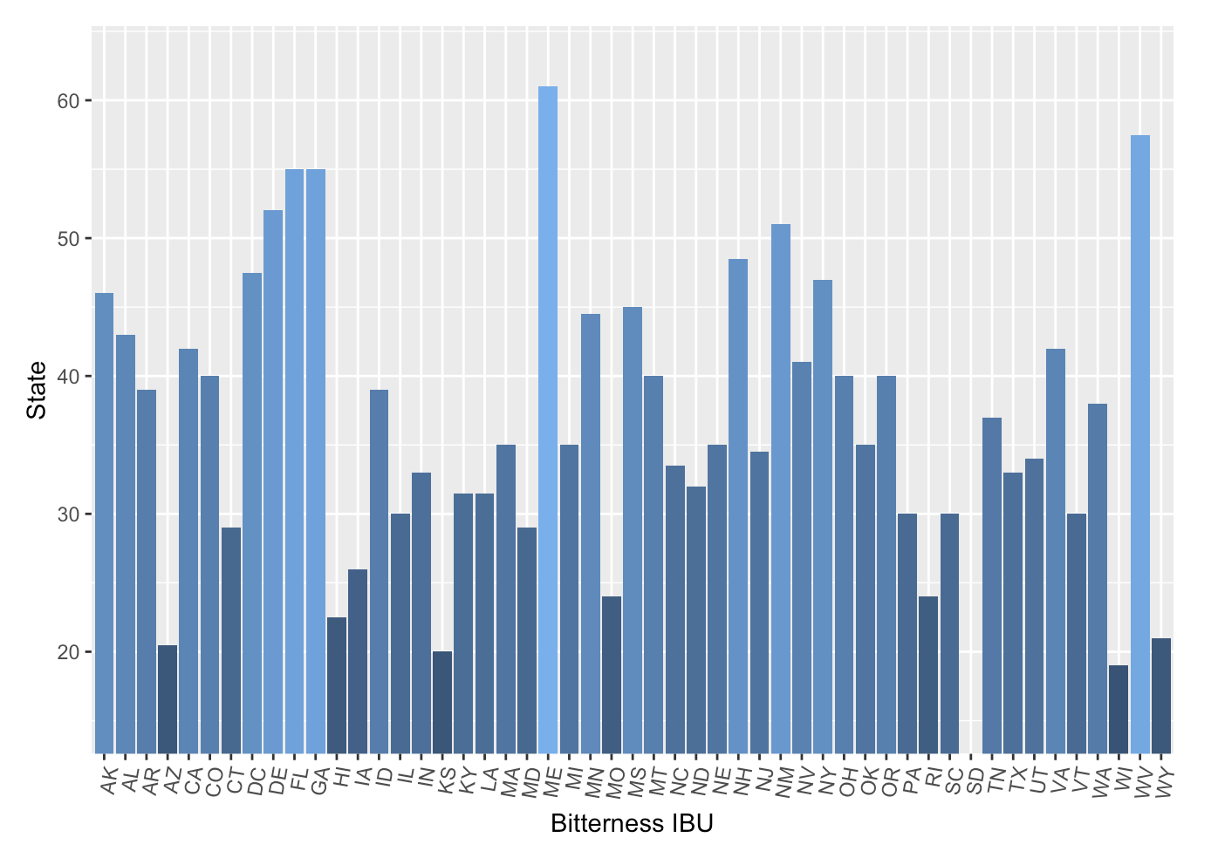
Median Bitterness IBU by State

Slide 7
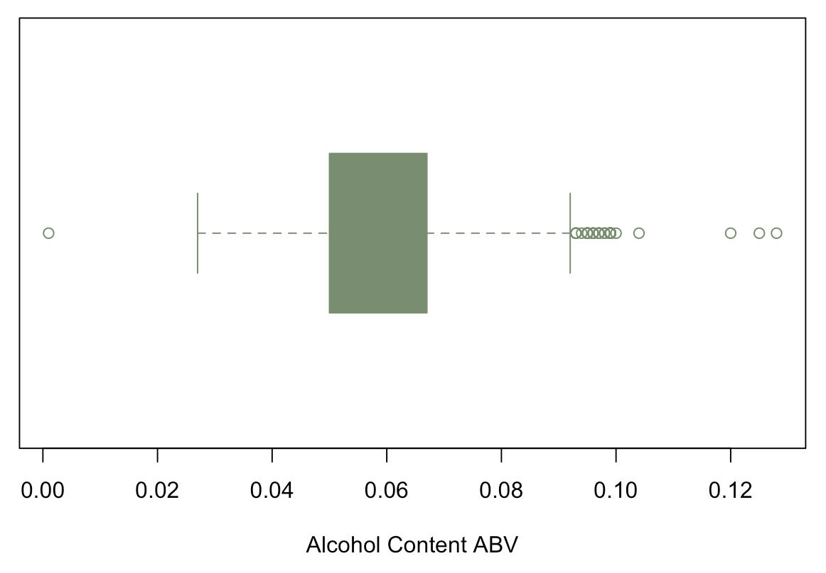
Summary of Alcohol Content ABV and The Most Alcoholic Beer
The most alcoholic beer is the Lee Hill Series Vol. 5 - Belgian Style Quadrupel Ale produced by Upslope Brewing Company in Boulder Colorado with an alcohol content of 0.128.

Slide 8
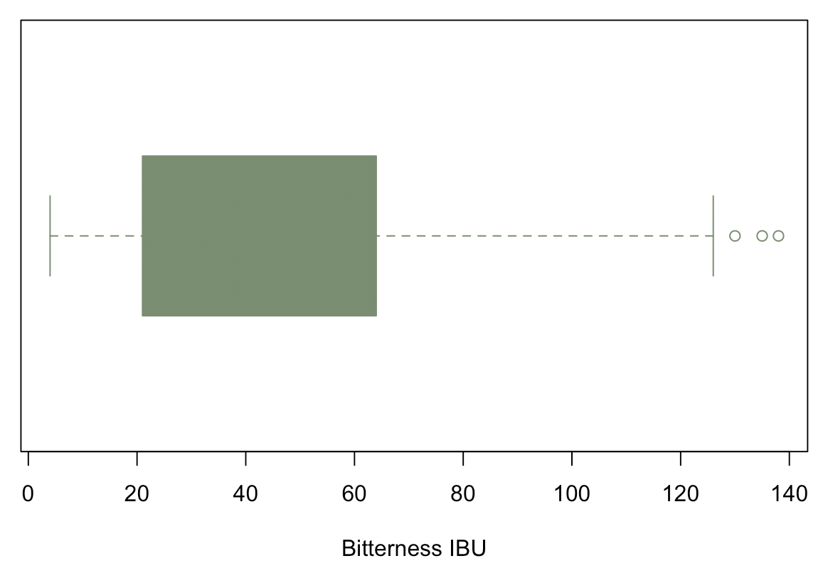
The Most Bitter Beer IBU
The most bitter beer is Bitter Bitch Imperial IPA produced by Astoria Brewing Company in Astoria Oregon with 1.38 international bitterness units.

Slide 9
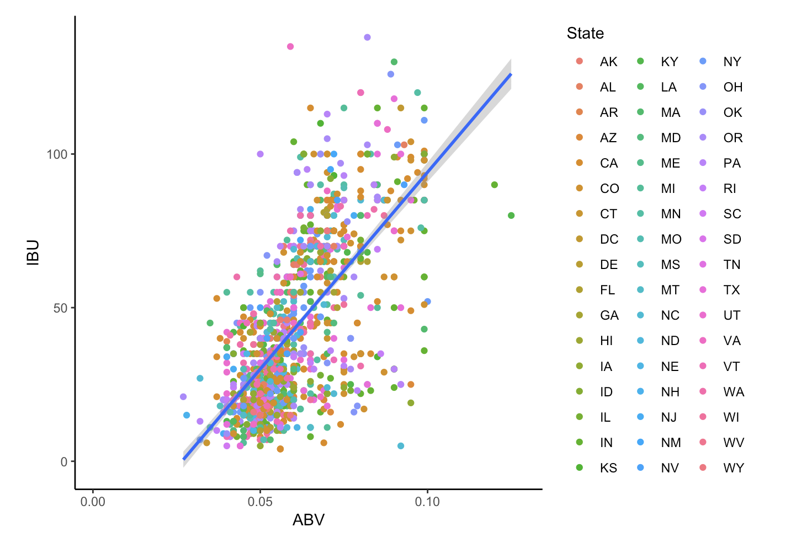
Alcohol Content ABV vs Bitterness IBU

Slide 10
Take Away
Assuming that beer companies are already making most popular combination of ABV and IBU we can recommend Frothy Head Brewing in launching it’s product to stick to the these ranges
Alcohol ABV between 0.05 and 0.07
Bitterness IBU between 25 and 50

Slide 11
Take Away
We recommend conducting an independent survey to find if there is any change in customer taste. This observed range is intended to serve as a baseline.
Alcohol ABV between 0.05 and 0.07
Bitterness IBU between 25 and 50

Slide 12
Take Away
We understand the company has a particular interest in Texas. These are the statistics for the state.
Median alcohol content of 0.055
Median bitterness of 32

